Slide 1
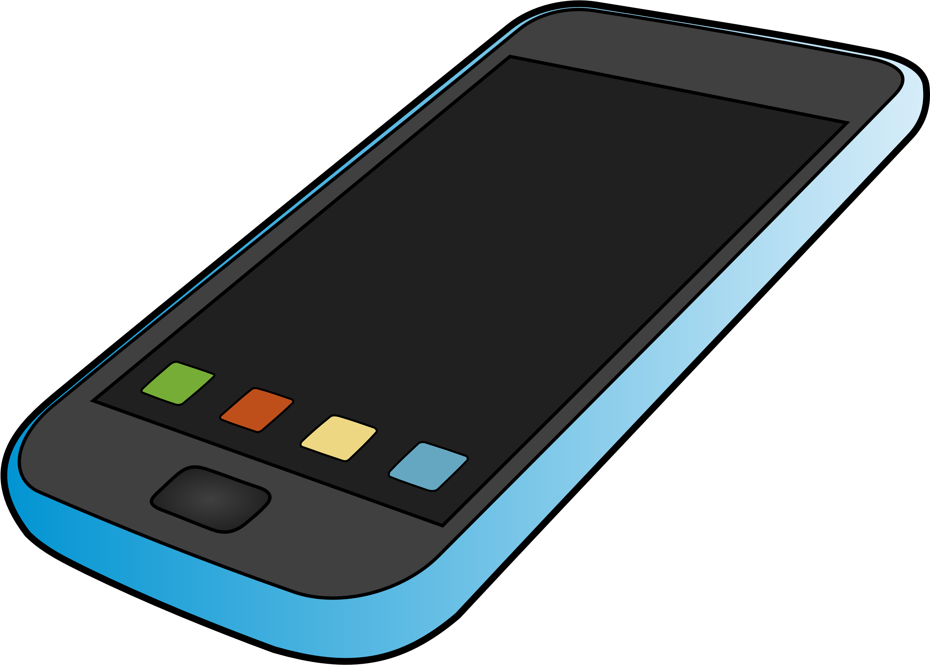
MOBILE PHONE RECOMMENDATION FOR Venture Drive
Notes:
NOTE:
To change the image on this slide, select the picture and delete it. Then click the Pictures icon in the placeholder to insert your own image.

Slide 2

Table of Content
Introduction
Problem statement
Product description
Criteria for selection
Conclusion
Recommendations
References
questions

Slide 3
INTRODUCTION
Venture Drive, a leading Company in leasing business spaces to investors.
Needs to reward the best sales team with mobile phones.

Slide 4
PROBLEM
For the 25 member team:
iPhone X
Samsung Galaxy S10
One Plus 8

Slide 5
Product Description
FEATURES
Enormous camera quality
Stylish look alongside edge to edge screen
Screen resolution of 2436 × 1125 and 456 pixels per inch
Facial Recognition
iPhone X

Slide 6
Product Description
Samsung Galaxy S10
FEATURES
High speed processor of up to 12GB RAM
Triple lens high quality Camera
User friendly AMOLED screen
Huge storage space.

Slide 7
Product Description
One Plus 8
FEATURES
Quality Triple Camera
Powerful software firm
Attractive structure (Slim)
Not as popular as iPhone x and Samsung Galaxy S10

Slide 8
Criteria for selection
Affordability
User friendly and Performance
Battery Capacity

Slide 9
Criteria 1: Affordability
iPhone X
- $1300
Samsung Galaxy S10
- $1259
One Plus 8
- $1099

Slide 10
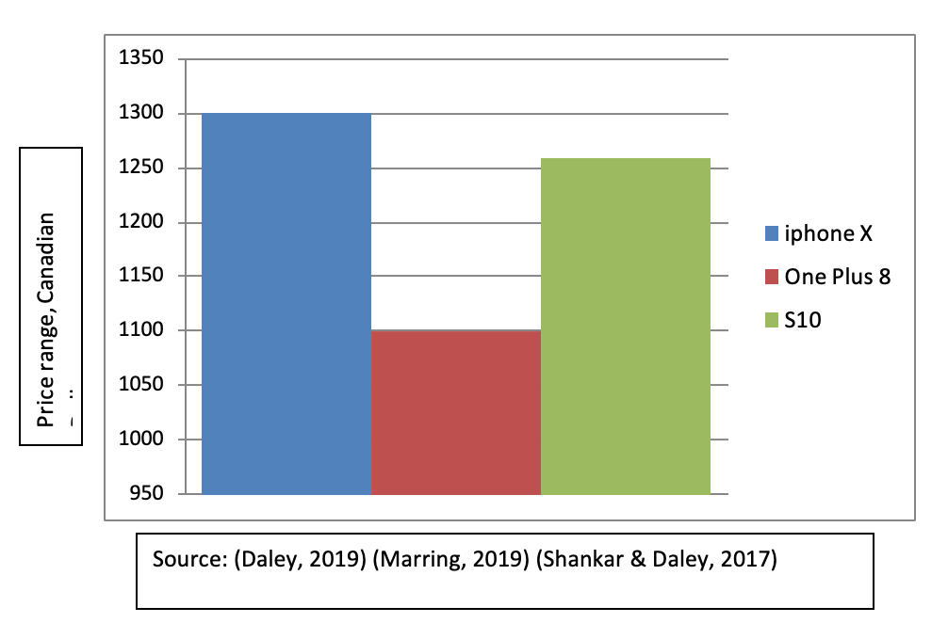
One Plus 8 is the most affordable

Slide 11
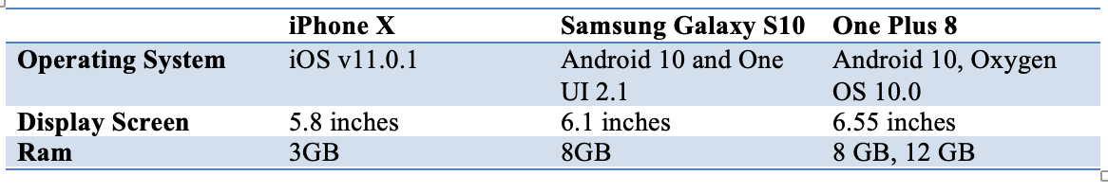
Criteria 2: User Friendly and Performance
 | Challenges
iPhone X | Difficult to fix if faulty
Sumsang Galaxy S10 | Appreciates by many
One plus 8 | Poorer Camera Quality and bulky
Samsung Galaxy S10 is the most User Friendly

Slide 12
Criteria 3: Battery Capacity
iPhone X
- 2716 mAH
Samsung
Galaxy S10
- 3300 mAH
One Plus 8
- 4300 mAH

Slide 13
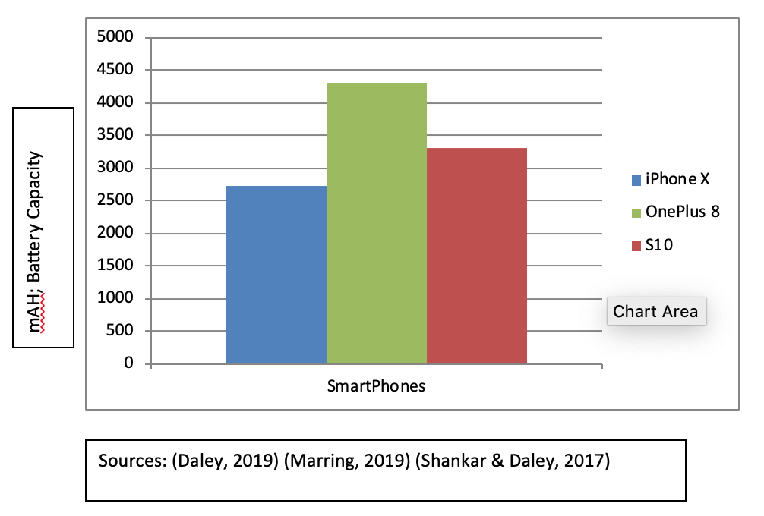
Criteria 3: Battery Capacity
One Plus 8 has a better battery life

Slide 14
Conclusion
iPhone X has a lot of elegance and ease to offer, it requires much more finance and is only more feasible if our employees had other apple products.
One Plus 8 has better battery life and is cheaper than the other two mobile phones.
Even though S10 is known for its user friendly features, One Plus 8 was very close in competition.

Slide 15
Recommendation
One Plus 8
Has increased advantage making it convenient for use by our companies employees.

Slide 16
References
Andrew, M. (2018, July 12). iPhone X. Retrieved August 1st, 2020, from https://www.macrumors.com/roundup/iphone-x/
Ben, J. (2019, May 12). Samsung Galaxy s10. Retrieved August 1st, 2020, from https://www.gadgetsnow.com/mobile-phones/Samsung-Galaxy-S10
Bennet, B. (2020, April 19). OnePlus 8 and 8 Pro now available to purchase in Canada. Retrieved August 1st, 2020, from https://mobilesyrup.com/2020/04/29/oneplus-8-8-pro-available-purchase-canada.
Daley, D. (2019, Feb 20). Here’s Canadian carrier pricing for Samsung’s Galaxy S10 series. Retrieved August 1, 2020, from https://mobilesyrup.com/2019/02/20/canadian-carrier-pricing-samsung- galaxy-s10
.

Slide 17
References – cont’d
.Marring, J. (2019, august 18). OnePlus 8 vs. Samsung Galaxy S10 Lite: Which should you buy? Retrieved August 1st, 2020, from https://www.androidcentral.com/oneplus-8-vs- samsung-galaxy-s10 lite
Shankar, B., & Daley, D. (2017, November 3rd). Apple's iPhone X is now available in Canada - MobileSyrup. Retrieved August 1st, 2020, from MobileSyrup: https://mobilesyrup.com/2017/11/03/apple-iphone-x-now-available-canada/

